Slide 1
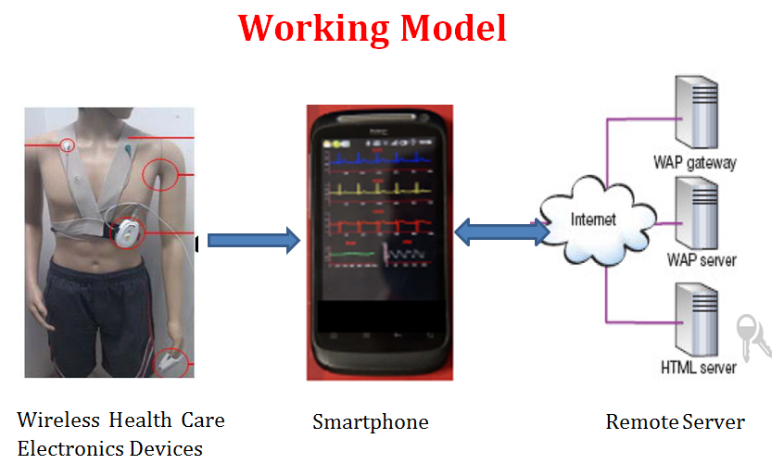
Cost Effective Mobile Base Health Monitoring System Under Cloud Environment.
Problem Statement
Methodology
Future Work and Challenges
To interpret health from their mobiles under cloud environment and creating a platform to hold the data on cloud for providing emergency service as per requirement within the time, and bridging the gap between the patient and the specialist.
1) Availability of: reliable communication networks, electrical power for device charging in remote rural locations, doctors
to report the ECGs on timely basis.
2) Seamless integration of various emergency response teams to take follow actions.
3) Developing and managing software clients for various different smartphones.
4) Slow adoption by medical professional / local administration agencies.
Introduction
Now a day, Health issue is a critical problem in the world, the leading causes of death across the world due increase in pollution, no proper daily routine, irregular diet much more. Every second in some part of the surroundings, a person suffers from chest pain or heart attack with the lack of early treatment systems. Due to increase of work schedule sometime peoples ignore health related issues as well as is ignoring due to health issue lack of money and other problems. In addition, the ratio of doctors attending patients is far less in lower and middle-income regions. In Addition, each person can use a smart mobile phone for communication and to complete daily workload in short routing, we can say that mobile phone is part of daily life. In this work, the system that has been designed to provide a telecardiology platform for remote health analysis and real time reporting from the doctor for the attending paramedic or the general practitioner.
Applications
Health Monitoring System
Smart Hospitality
Continuous Patient Monitoring System
Primary Health care in Rural Area.
CONCLUSIONS
Description
Mobile Based Health Monitoring System is very useful technology with many benefits for medical applications, patients and society by continuous monitoring and early detection of diseases.
By using this system medical healthcare system will improve their performance and will be useful for reducing death rate.
It provide Quality of Service, low power consumption, and Cost effective continuous health monitoring and mobility.
Objectives
Working:
The project objective is to develop mobile base application that will collect data from wireless health care electronic devices, display the same on mobile phone help patient for preliminary assessment and sync the important information to server location i.e. to doctor in hospital.
A web application will develop for displaying the collected information at server for monitoring health related issue. Propose work in which alerts, reminders and emergency notifications for vital measurements help patient and doctors to take timely decisions in emergencies.
Doctors can monitor the patient’s status at all the time using the web interface at any remote location as android application keeps synchronizing the test data using the web services with application server.
Web app also works as reporting tool where one can view all the history for the patient’s test performed over the period. High-level goal will be achieved when patient’s at remote places can be monitored without physical presence of the specialist professionals at given locations.
To provide cost effective solution to solve health related issue in remote or rural side area.
To provide portable platform for checking Health related problem.
To provide the preliminary assessment to patient related to heart.
To reduce gap between doctor/specialist and patient for solving the problem related to health.
Wireless communication enable device can help to maintain related information on mobile phone and it can transfer to the hospitals to monitor the health status of the patient
Mobile based communication systems can help to ambulance center about emergency and address location of patient.
To provide information regarding pulse rate, body temperature and alert system can help to maintain regulation in diet, medicine. To develop web based server to maintain information of patients.
REFERENCES
http://www.who.int/medical_devices
Zhen Fang, Zhan Zhao, Fangmin Sun, etal. The 3AHcare Node: Health Monitoring Continuously. 2012 IEEE 14th International Conference on e-Health Networking, Applications and Services (Healthcom). 10-13 October 2012 in Beijing, China.
Rifat Shahriyar, Md. Faizul Bari, Gourab Kunda. Intelligent Mobile Health Monitoring System (IMHMS), Springer, Electronics HealthCare Volume 27, 2013, pp 5-12.

